Slide 1


Polyglot Persistence and Big Data
Al.I. Cuza University of Iași
Faculty of Economics and Business Administration
Department of Accounting, Information Systems and Statistics
Graph Databases. Neo4j
By Marin Fotache

Slide 2
Main Resources

Slide 3
Free Courses on Graph Academy https://neo4j.com/graphacademy/online-training/
Overview of Neo4j 4.x
Querying with Cypher in Neo4j 4.x
Creating Nodes and Relationships in Neo4j 4.x
Graph Data Modeling for Neo4j
Implementing Graph Data Models in Neo4j 4.x
Importing Data with Neo4j 4.x

Slide 4
Free e-Book
Graph Databases For Dummies (Jim Webber and Rik van Bruggen) 2020
Freely available at:
https://neo4j.com/graph-databases-for-dummies/

Slide 5
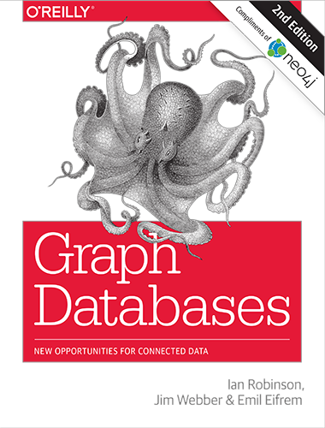
Free e-Book
Graph Databases (Ian Robinson, Jim Webber and Emil Eifrem) 2015
Freely available at:
https://neo4j.com/graph-databases-book/

Slide 6
Another Free (mini) e-Book
Michael Hunger, Ryan Boyd & William Lyon, The Definitive Guide
to Graph Databases
for the RDBMS Developer, Neo Technology, 2016
Freely available at:
https://neo4j.com/whitepapers/rdbms-developers-graph-databases-ebook/

Slide 7
Video-Tutorials on Installing and Working with Neo4j
Neo4j (Graph Database) Crash Course (Nov. 2021)
https://www.youtube.com/watch?v=8jNPelugC2s
install neo4j (Windows) (April, 2021)
https://www.youtube.com/watch?v=8tNf773uDto
Getting Started with Neo4j Desktop 1.2.7 on Windows (Download, Install, Setup) (2020)
https://www.youtube.com/watch?v=RSbhmVF_ccs
Creating a Blank Neo4j Sandbox (2019)
https://www.youtube.com/watch?v=OSk1ePl2PUM&list=PL9Hl4pk2FsvV1u8JY_TKTnYddujp8I7dn

Slide 8
Video-Tutorials on Installing and Working with Neo4j (cont)
Getting Started with Neo4j Desktop 1.2.6 on OS X (Download, Install, Setup) (2020)
https://www.youtube.com/watch?v=cTZ_Z3KfLyE&list=PL9Hl4pk2FsvV1u8JY_TKTnYddujp8I7dn&index=4
Get Started with Neo4j Browser for Neo4j 4.0 (Query, Update, Visualize) (2020)
https://www.youtube.com/watch?v=oHo-lQ79zf0&list=PL9Hl4pk2FsvV1u8JY_TKTnYddujp8I7dn&index=6
GettingStartedDesktop 1 4 1 (2021)
https://www.youtube.com/watch?v=uR9-NLxLzg4&list=PL9Hl4pk2FsvV1u8JY_TKTnYddujp8I7dn&index=14
Neo4J - How to Install on Windows
https://www.youtube.com/watch?v=3Zhr9uShjlI

Slide 9
Video-Tutorials on: graph modeling and queries (1)
Introduction to Neo4j and Graph Databases (2019)
https://www.youtube.com/watch?v=oRtVdXvtD3o
Intro to Graph Thinking
https://www.youtube.com/watch?v=z3Tvjf0buc8
Intro to Neo4j (2016)
https://www.youtube.com/watch?v=Yzbk6VaavoM
Intro to Neo4j (2016)
https://www.youtube.com/watch?v=U8ZGVx1NmQg
Neo4j Graph Database & Cypher
https://www.youtube.com/watch?v=1kyPUqU-MkE&t=1391s
Ian Robinson: Designing and Building a Graph Database Application (2013)
https://www.youtube.com/watch?v=97vQHT973eo

Slide 10
Video-Tutorials on: graph modeling and queries (2)
Moving from RDBMS to Graphs (2015)
https://www.youtube.com/watch?v=1mhT8WLgi1g&spfreload=10
Tips and Tricks for Graph Data Modeling 2015
https://www.youtube.com/watch?v=78r0MgH0u0w
05 October 14, 2014 - Intro to Cypher
https://www.youtube.com/watch?v=VdivJqlPzCI&spfreload=10
Neo4j Graph Database & Cypher
https://www.youtube.com/watch?v=1kyPUqU-MkE
Intro to Cypher for the SQL Developer
https://www.youtube.com/watch?v=RIWuA_K7_GY
Let's revisit modelling and loading data (2021)
https://www.youtube.com/watch?v=7fk7oll13u4&list=PL9Hl4pk2FsvWaA5pThriHAOo1-fkoulLi

Slide 11
Basic Concepts of Graph Databases

Slide 12
Graphs
Formally: a graph is just a collection of vertices and edges
Pragmatic view: a graph a set of nodes and the relationships that connect them.
DB view: Graphs represent
entities as nodes and
the ways in which those entities relate to the world as relationships.
What can be modeled by graph databases:
Manufacturing
System of roads
Supplychain
Social networks
Etc.

Slide 13
The Labeled Property Graph Model
A labeled property graph is made up of
nodes,
relationships,
properties,
labels.
Nodes
Contain properties
Are documents that store properties as key-value pairs
In Neo4j, the keys are strings and the values are primitive data types, plus arrays of these types
Nodes can be tagged with one or more labels that indicate the roles they play within the dataset
Relationships
Connect nodes
Structure the graph
Always has a direction, a single name, and a start node and an end node
Can also have properties

Slide 14
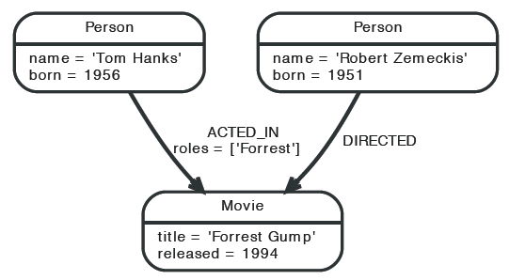
A Basic Graph
Source: The Neo4j Manual, 2015

Slide 15
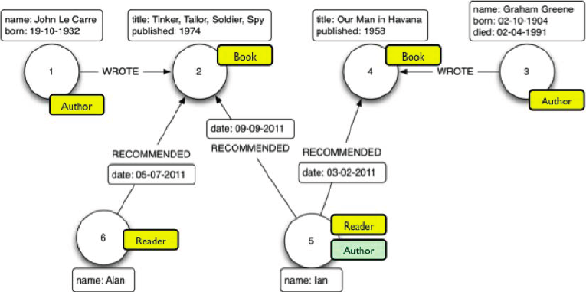
A Labeled Property Graph
Source: Van Bruggen, 2015

Slide 16
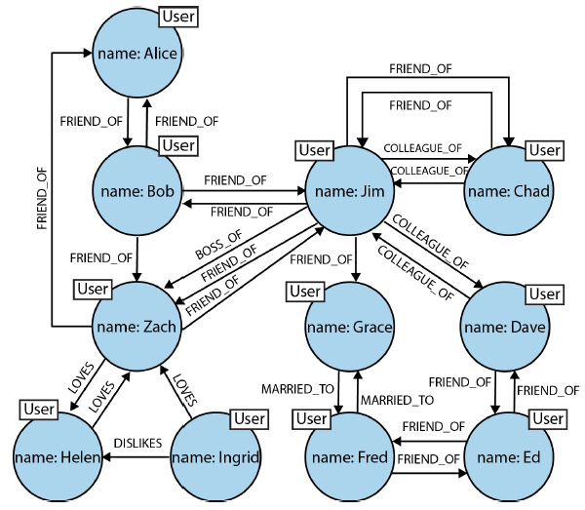
Relatioships in Graph Databases
Source: Robinson, Webber, Eifren 2015

Slide 17
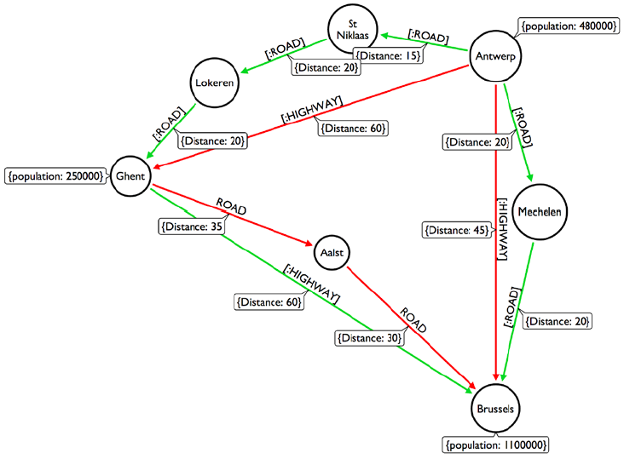
A Route Graph
Source: Van Bruggen, 2015

Slide 18
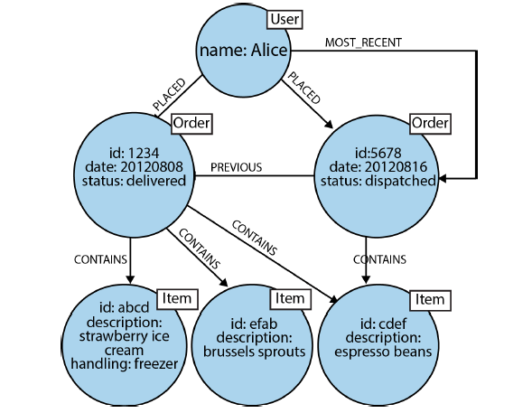
Modeling Order History in a Graph
Source: Robinson, Webber, Eifren 2015

Slide 19
Introduction to Cypher (A high level query language for graph databases)

Slide 20
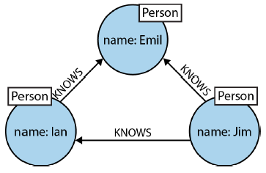
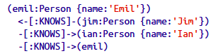
Cypher Fundamentals
Three mutual friends
Nodes represents people (are of type :Person)
emil, jim and ian are nodes identifiers
Each node has one property – name (properties are declared as key-value pairs)
Each pair of nodes is connected through relationships :KNOWS
Source: Robinson, Webber, Eifren 2015

Slide 21
Create Nodes
Create nodes associated with Romania's main regions in a single statement
The name of the region is its identifier
The type (label) of each node is :Region
All nodes have a single property - regionName
CREATE
(Moldova:Region { regionName :'Moldova' }),
(Muntenia:Region { regionName : 'Muntenia' }),
(Transilvania:Region { regionName :
'Transilvania' }),
(Banat:Region { regionName :'Banat' }) ;

Slide 22
Create Nodes (cont.)
Create nodes associated with counties (each is labeled "County")
Counties identifiers are not their names (as with regions), because there are counties – e.g. Satu Mare – having two word names also also there are counties with names identifical to their capitals (Suceava, Vaslui, etc.)
The type (label) of each node is :County
All nodes have a single property – countyName
CREATE
(Iasi_County:County { countyName : 'Iasi' }),
(Vaslui_County:County { countyName : 'Vaslui' }),
(Vrancea:County { countyName : 'Vrancea' }),
(Buzau_County:County { countyName : 'Buzau' }),
(Galati_County:County { countyName : 'Galati' }),
(Braila_County:County { countyName : 'Braila' }),
(Neamt:County { countyName : 'Neamt' }),
(Bacau_County:County { countyName : 'Bacau' }) ;

Slide 23
Create Relationships
Create relationships [:IS_IN_REGION] specifying each county's region
Syntax below is (a bit) closer to SQL
MATCH (c:County),(r:Region)
WHERE c.countyName = 'Iasi' AND
r.regionName = 'Moldova'
CREATE (c)-[rel:IS_IN_REGION]->(r) ;
MATCH (c:County),(r:Region)
WHERE c.countyName = 'Vrancea' AND
r.regionName = 'Moldova'
CREATE (c)-[rel:IS_IN_REGION]->(r) ;
MATCH (c:County),(r:Region)
WHERE c.countyName = 'Buzau' AND
r.regionName = 'Muntenia'
CREATE (c)-[rel:IS_IN_REGION]->(r) ;

Slide 24
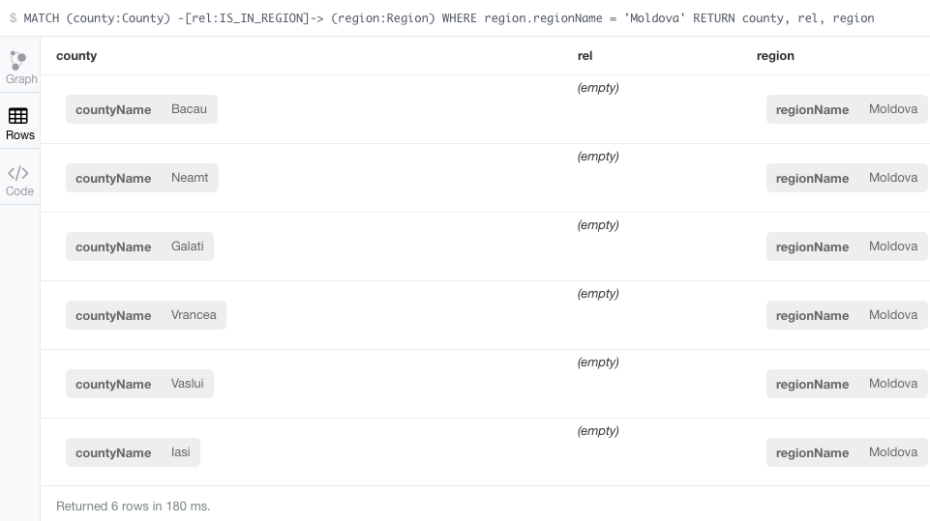
First Cypher Query
Display all the counties in Moldova region – tabular view

Slide 25
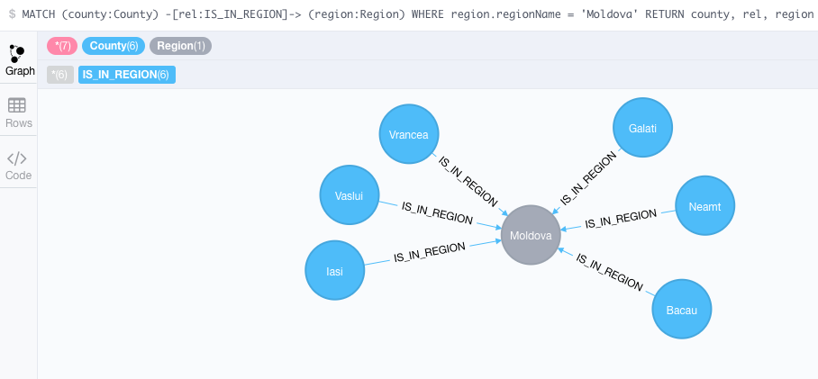
First Cypher Query (cont.)
Display all the counties in Moldova region – graph view

Slide 26
First Cypher Query (cont.)
Three slighly different syntax versions
MATCH (county:County) -[rel:IS_IN_REGION]-> (region:Region)
WHERE region.regionName = 'Moldova'
RETURN county, rel, region
MATCH (county:County) -[rel:IS_IN_REGION]-> (region:Region {regionName : 'Moldova' } )
RETURN county, rel, region
MATCH (county:County) --> (region:Region {regionName : 'Moldova' } )
RETURN county, region

Slide 27
Nodes Associated to Cities
Nodes type (label) is City
All nodes (except Tisita) have two properties – cityName and population
CREATE (Iasi:City { cityName:'Iasi', population: 290422 }) ;
CREATE (Tg_Frumos:City { cityName:'Tirgu Frumos',
population: 9386 }) ;
CREATE (Vaslui:City { cityName:'Vaslui', population: 55407 }) ;
CREATE (Barlad:City { cityName:'Barlad', population: 55837 }) ;
CREATE (Tecuci:City { cityName:'Tecuci', population: 34871 }) ;
CREATE (Tisita:City { cityName:'Tisita'}) ;
CREATE (Focsani:City { cityName:'Focsani', population: 79315 }) ;
CREATE (Rimnicu_Sarat:City { cityName:'Rimnicu Sarat',
population: 33843 }) ;
CREATE (Galati:City { cityName:'Galati', population: 249432 }) ;
CREATE (Braila:City { cityName:'Braila', population: 180302 }) ;
CREATE (Roman:City { cityName:'Roman', population: 50713 }) ;
CREATE (Bacau:City { cityName:'Bacau', population: 144307 }) ;
CREATE (Adjud:City { cityName:'Adjud', population: 16045 }) ;

Slide 28
Relationships Declaring Each City's County
MATCH (city:City),(county:County)
WHERE city.cityName IN ['Iasi', 'Tirgu Frumos'] AND county.countyName = 'Iasi'
CREATE (city)-[rel:IS_IN_COUNTY]->(county) ;
MATCH (city:City),(county:County)
WHERE city.cityName IN ['Vaslui', 'Barlad'] AND county.countyName = 'Vaslui'
CREATE (city)-[rel:IS_IN_COUNTY]->(county) ;
MATCH (city:City),(county:County)
WHERE city.cityName IN ['Tecuci', 'Galati'] AND county.countyName = 'Galati'
CREATE (city)-[rel:IS_IN_COUNTY]->(county) ;

Slide 29
Relationships for Paths Among Cities
Nodes connects through relationships [:CONNECTED_TO]
Relationships have a property – distance
//# Iasi - Vaslui: 71 km
MATCH (from:City) WHERE from.cityName = 'Iasi'
MATCH (to:City) WHERE to.cityName = 'Vaslui'
WITH from, to CREATE (from) -[r:CONNECTED_TO { distance: 71}]-> (to) ;
//# Iasi - Tg.Frumos: 53km
MATCH (from:City) WHERE from.cityName = 'Iasi'
MATCH (to:City) WHERE to.cityName = 'Tirgu Frumos'
WITH from, to CREATE (from) -[r:CONNECTED_TO { distance: 53}]-> (to) ;
//# Tg.Frumos - Roman: 40
MATCH (from:City)
WHERE from.cityName = 'Tirgu Frumos'
MATCH (to:City)
WHERE to.cityName = 'Roman'
CREATE (from) -[r:CONNECTED_TO { distance: 40}]-> (to);

Slide 30
Queries for Displaying Basic Information
Display the labels (types) of nodes in the database
MATCH (n)
RETURN DISTINCT labels(n)
Display all the nodes in the database
MATCH (n)
RETURN n, labels(n)
Display all the City nodes (with their properties) ordered by city names
MATCH (n:City)
RETURN n
ORDER BY n.cityName
Get "some" data - see the next slide
MATCH (n) RETURN n LIMIT 100

Slide 31
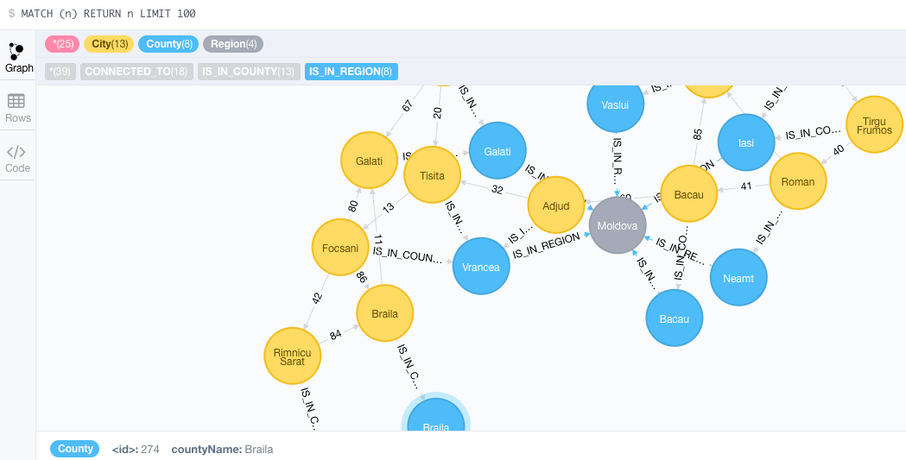
MATCH (n) RETURN n LIMIT 100

Slide 32
Paths of Relationships
Which are the cities in the same county as the city of Adjud ?
Tabular result
MATCH (city1:City) -[relCounty:IS_IN_COUNTY]
->(county:County) <-
[relCounty2:IS_IN_COUNTY]- (city2:City)
WHERE city1.cityName = 'Adjud'
RETURN city2.cityName
Graph result (see next slide)
MATCH (city1:City) -[relCounty:IS_IN_COUNTY]
->(county:County) <-
[relCounty2:IS_IN_COUNTY]- (city2:City)
WHERE city1.cityName = 'Adjud'
RETURN *

Slide 33
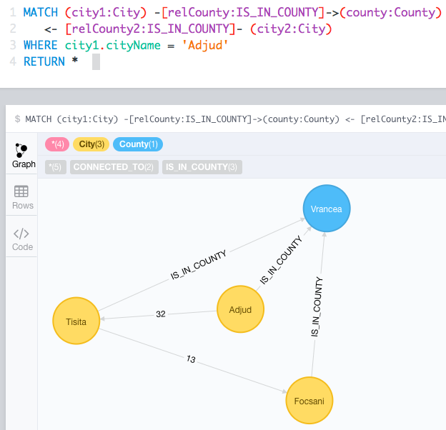
Paths of Relationships (cont.)
Cities in the same county as the city of Adjud - displayed as graph

Slide 34
A Longer Path of Relationships
Which are the cities in the same region as the city of Adjud ? (Graph result)
MATCH
(city1:City)
-[relCounty:IS_IN_COUNTY]->
(county:County)
-[relRegion:IS_IN_REGION]->
(region:Region)
<- [relRegion2:IS_IN_REGION]-
(county2:County)
<- [relCounty2:IS_IN_COUNTY]-
(city2:City)
WHERE city1.cityName = 'Adjud'
RETURN *

Slide 35
Aggregation Queries - COUNT
How many cities are in the "Moldova" region?
MATCH
(city:City)
-[relCounty:IS_IN_COUNTY]->
(county:County)
-[relRegion:IS_IN_REGION]->
(region:Region{ regionName: 'Moldova' })
RETURN count(*)

Slide 36
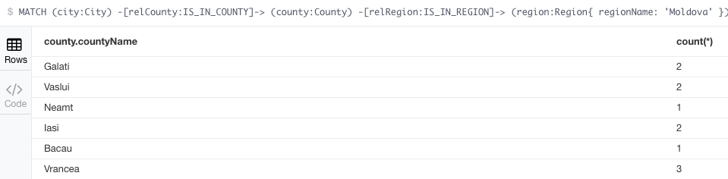
Aggregation Queries – GROUP BY
Display the number of cities in every county of "Moldova" region?
MATCH (city:City)
-[relCounty:IS_IN_COUNTY]-> (county:County)
-[relRegion:IS_IN_REGION]->
(region:Region{ regionName: 'Moldova' })
RETURN county.countyName, count(*)

Slide 37
GROUP BY Two Properties
Display the number of cities in every county of every region (see next slide for results)
MATCH
(city:City)
-[relCounty:IS_IN_COUNTY]->
(county:County)
-[relRegion:IS_IN_REGION]->
(region:Region)
RETURN region.regionName, county.countyName, count(*)
ORDER BY region.regionName, county.countyName

Slide 38
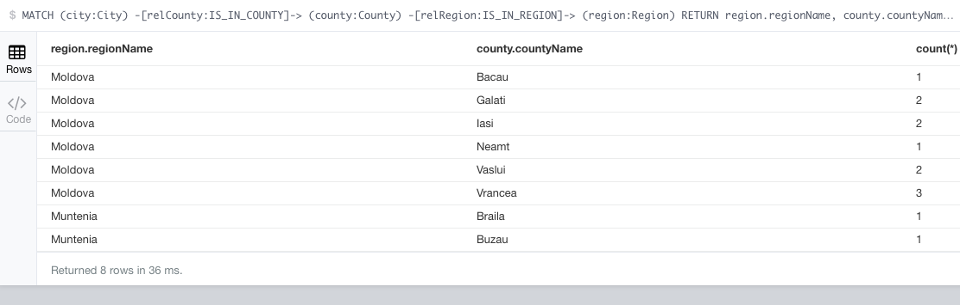
GROUP BY Two Properties (result)
Display the number of cities in every county of every region

Slide 39
GROUP BY and HAVING
Display the counties with more than one city in the database (see next slide for results)
MATCH
(city:City)
-[relCounty:IS_IN_COUNTY]->
(county:County)
WITH county.countyName AS countyName, count(*) AS n_of_cities
WHERE n_of_cities > 1
RETURN *

Slide 40
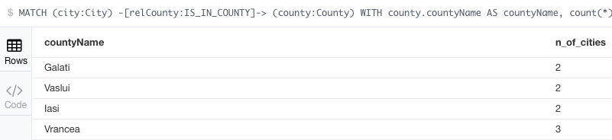
GROUP BY and HAVING (results)
Display the counties with more than one city in the database

Slide 41
Rankings
Display the county with the greatest number of cities
Query below displays just one county. In case there are two or more counties with the same maximum number of cities, there is no one-query solution for displaying all those counties
MATCH
(city:City)
-[relCounty:IS_IN_COUNTY]->
(county:County)
RETURN county.countyName, count(*)
ORDER BY count(*) DESC LIMIT 1

Slide 42
Graphs & Paths in Cypher

Slide 43
Paths in Cypher
As expected, this the area where graph databases/Neo4j excels
Number of nodes a path pass throug is qualified by:
A number, e.g. [rel:CONNECTED_TO*2]
A pair of numbers, e.g. [rel:CONNECTED_TO*0..2]

Slide 44
First-Order Neighbours
Display the neighbor cities of Iasi, including the anchor (path departure node - Iasi)
These are first order neighbours
MATCH
(n:City { cityName: 'Iasi' })
-[:CONNECTED_TO*0..1]-
(neighborhood)
RETURN neighborhood
For result – see next slide

Slide 45
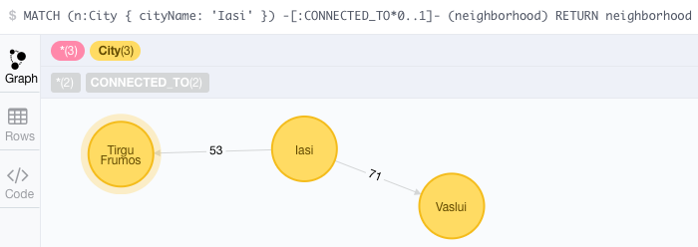
First-Order Neighbours (result)

Slide 46
Filtering the Path Nodes
Display the neighbor cities of Iasi (first order neighbours) with more than 30000 inhabitants
Filter applies to a node property
MATCH
(n:City { cityName: 'Iasi' })
-[:CONNECTED_TO*1]-
(neighborhood)
WHERE neighborhood.population >= 30000
RETURN neighborhood

Slide 47
Filtering the Path Relationships
Display the neighbor cities of Iasi (first order neighbors) found at exactly 53 km from Iasi
Filter applied to relationships - equality operator
MATCH
(n:City { cityName: 'Iasi' })
-[rel:CONNECTED_TO*1{distance:53}]-
(neighborhood)
RETURN *

Slide 48
Trouble With Path Relationship Filter
Display the neighbor cities of Iasi (first order neighbors) within less than 60 kilometers
Filter applied to relationships – greater than operator
MATCH
(n:City { cityName: 'Iasi' })
-[rel:CONNECTED_TO*1]-
(neighborhood)
WHERE rel.distance <= 60
RETURN *
Does NOT Work!!! – see a later slide (collections)

Slide 49
Second-Order Neighbours
Display only the neighbours of the neighbours of Iasi
These are second order neighbours
MATCH
(n:City { cityName: 'Iasi' })
-[:CONNECTED_TO*0..1]-
(neighborhood)
RETURN neighborhood
For result – see next slide

Slide 50
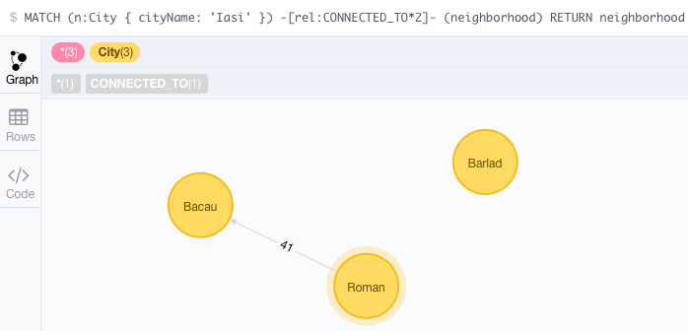
Second-Order Neighbours (result)
The second-order neighbours of Iași

Slide 51
Third- and Fourth-Order Neighbours
Display only the third and fourth order neighbours of Iasi
MATCH
(n:City { cityName: 'Iasi' })
-[rel:CONNECTED_TO*3..4]-
(neighborhood)
RETURN neighborhood
For result – see next slide

Slide 52
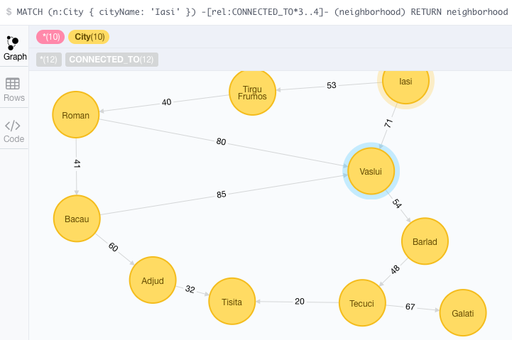
Third- and Fourth-Order Neighbours (result)
Display only the third and fourth order neighbours of Iasi (result)

Slide 53
Remaining Agenda (for Lectures and Labs)
Mini case-study: Querying `Books` database (adapted from O. Panzarino)
Mini case-study: Transportation (routes) l
Northwind database (import and queries)
http://neo4j.com/developer/guide-importing-data-and-etl/
Case study: DB `Sales`
import data from PostgreSQL/Oracle (creating nodes and relationships)
main query options (Cypher)

